Slide 1

Sustainable. Distributed. Utility scale.
Renewable energy.

Slide 2
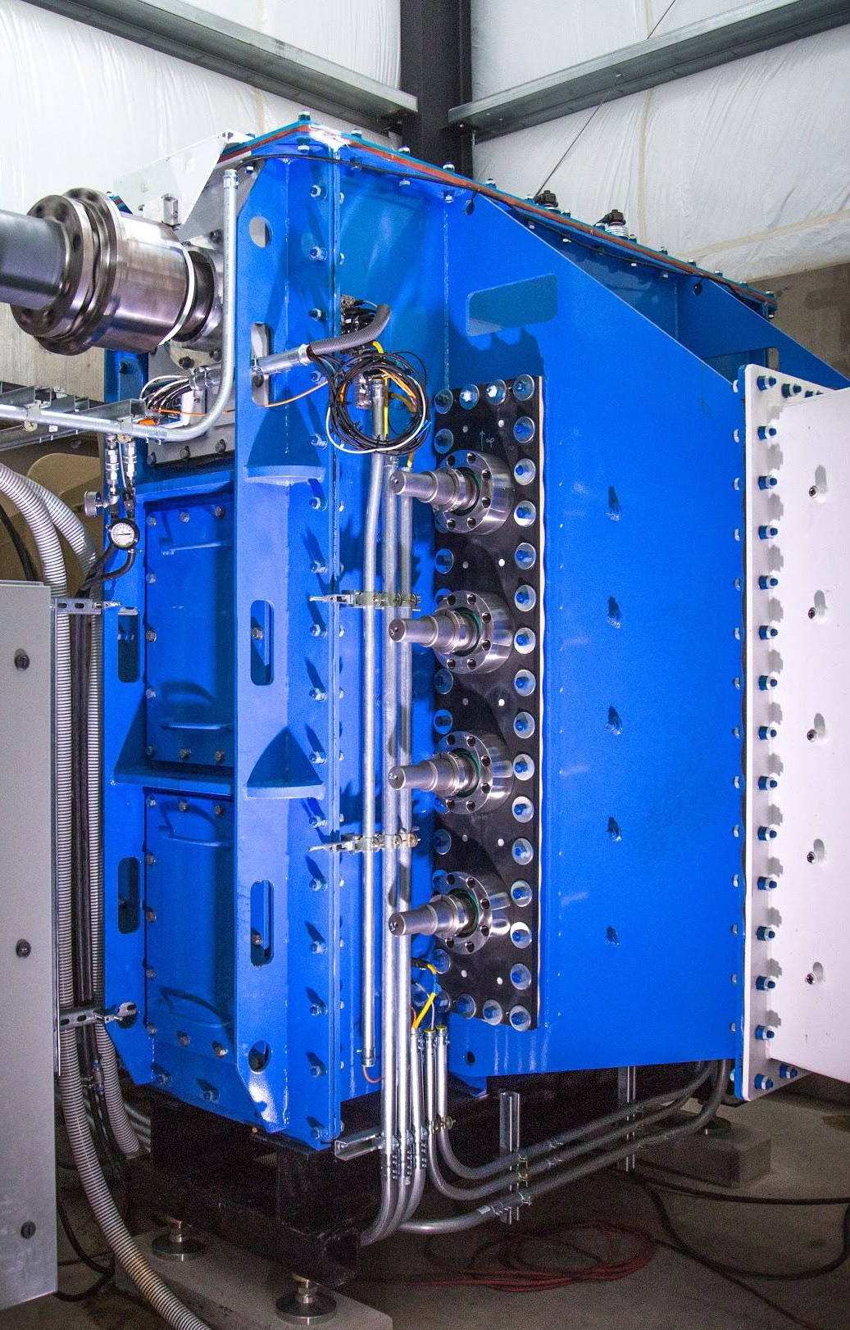
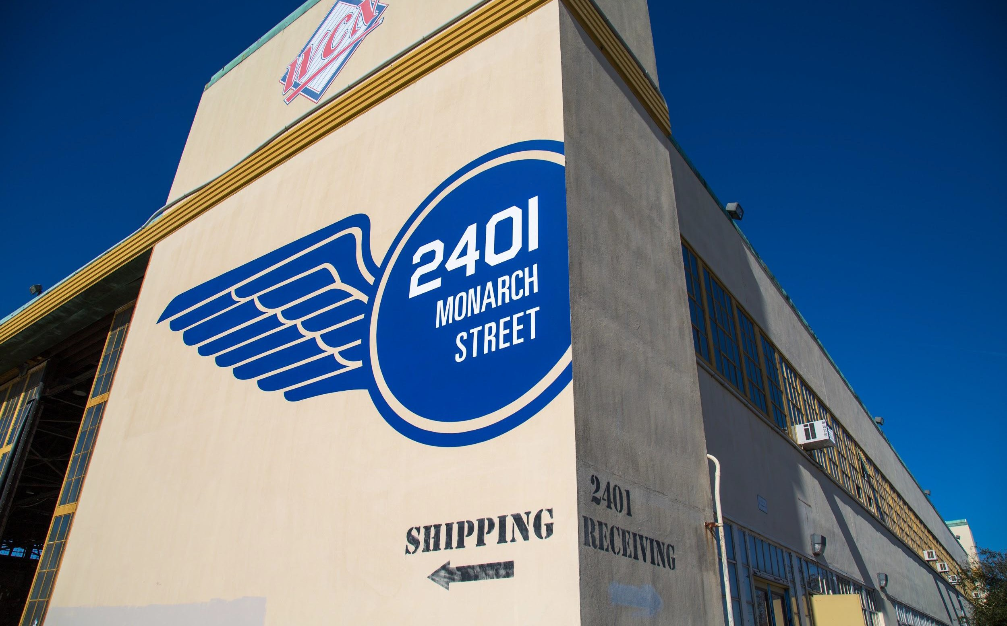
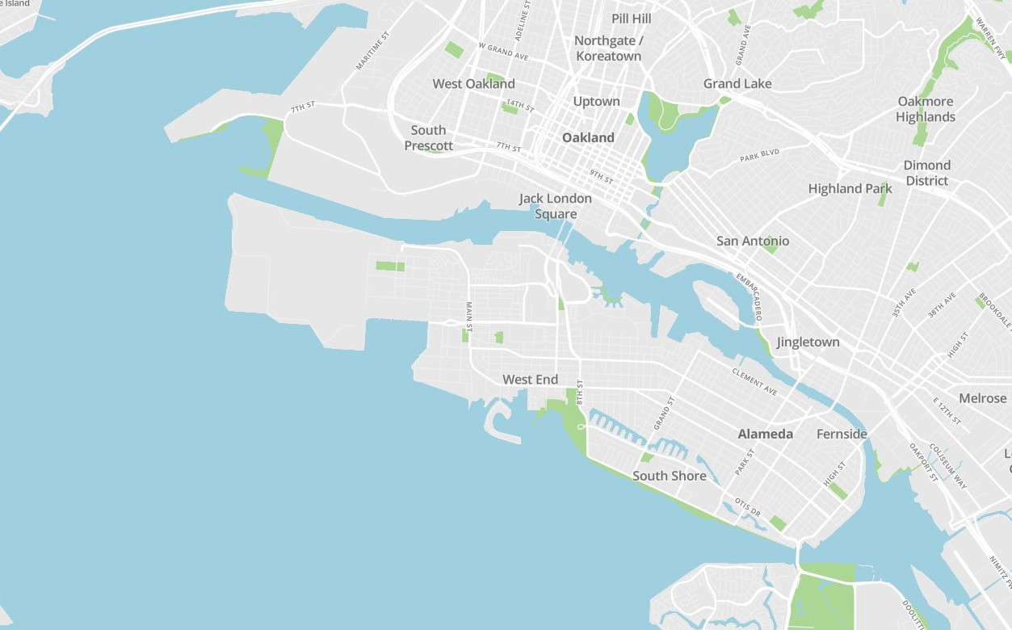

Natel Energy is...
...a water+energy company based in Alameda, California.
...driven by a vision of climate resilient, low cost, hydropower that solves the problems inhibiting traditional hydropower development:
slow and capital intensive to develop
negative environmental and community impacts
inflexible in the face of climate uncertainty
Our mission?
To redraw the map of how and where hydropower is developed.

Slide 3
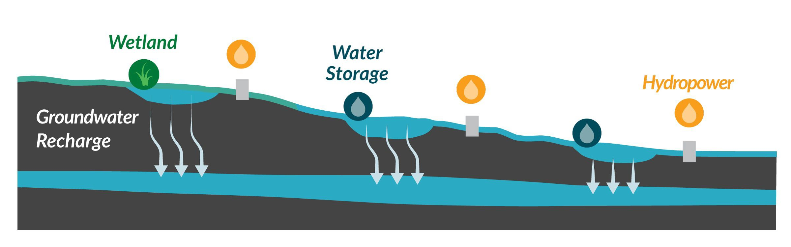
Natel Energy makes distributed, baseload, renewable hydropower with...
...the hydroEngine™, Natel's innovative, proprietary, low-head turbine
...watershedOS, a proprietary analytics platform to plan, optimize, and operate sustainable and beneficial EcoSmartHydro™
at medium and large scales.
watershedOS is the brains hydroEngines™ are the bricks EcoSmartHydro™ is the blueprint

Slide 4
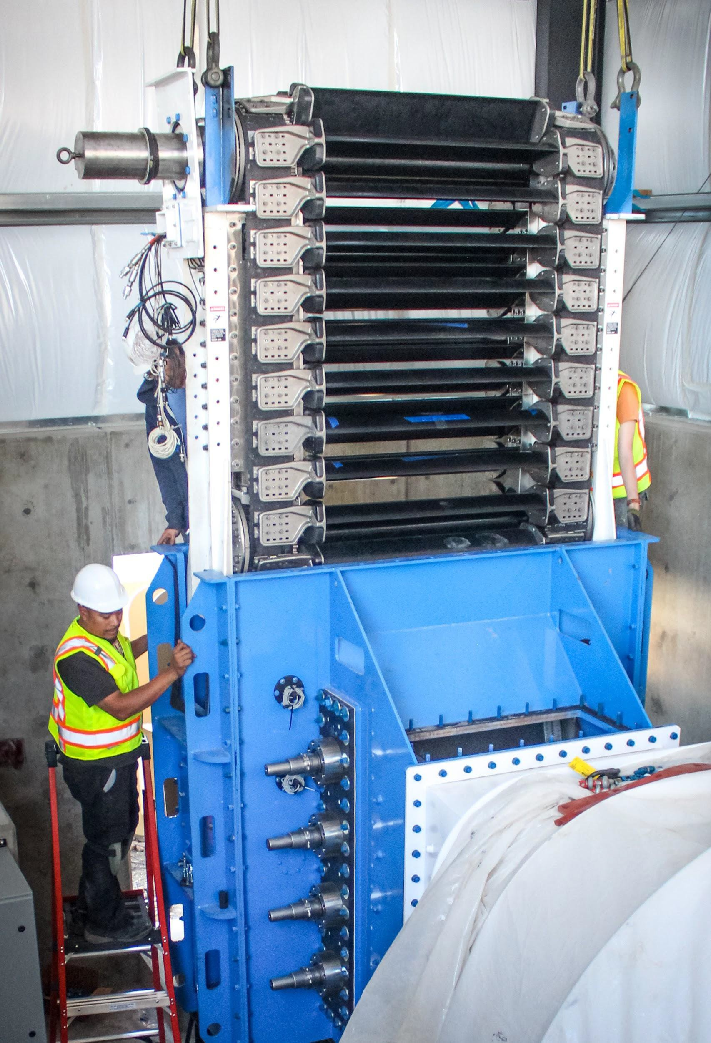
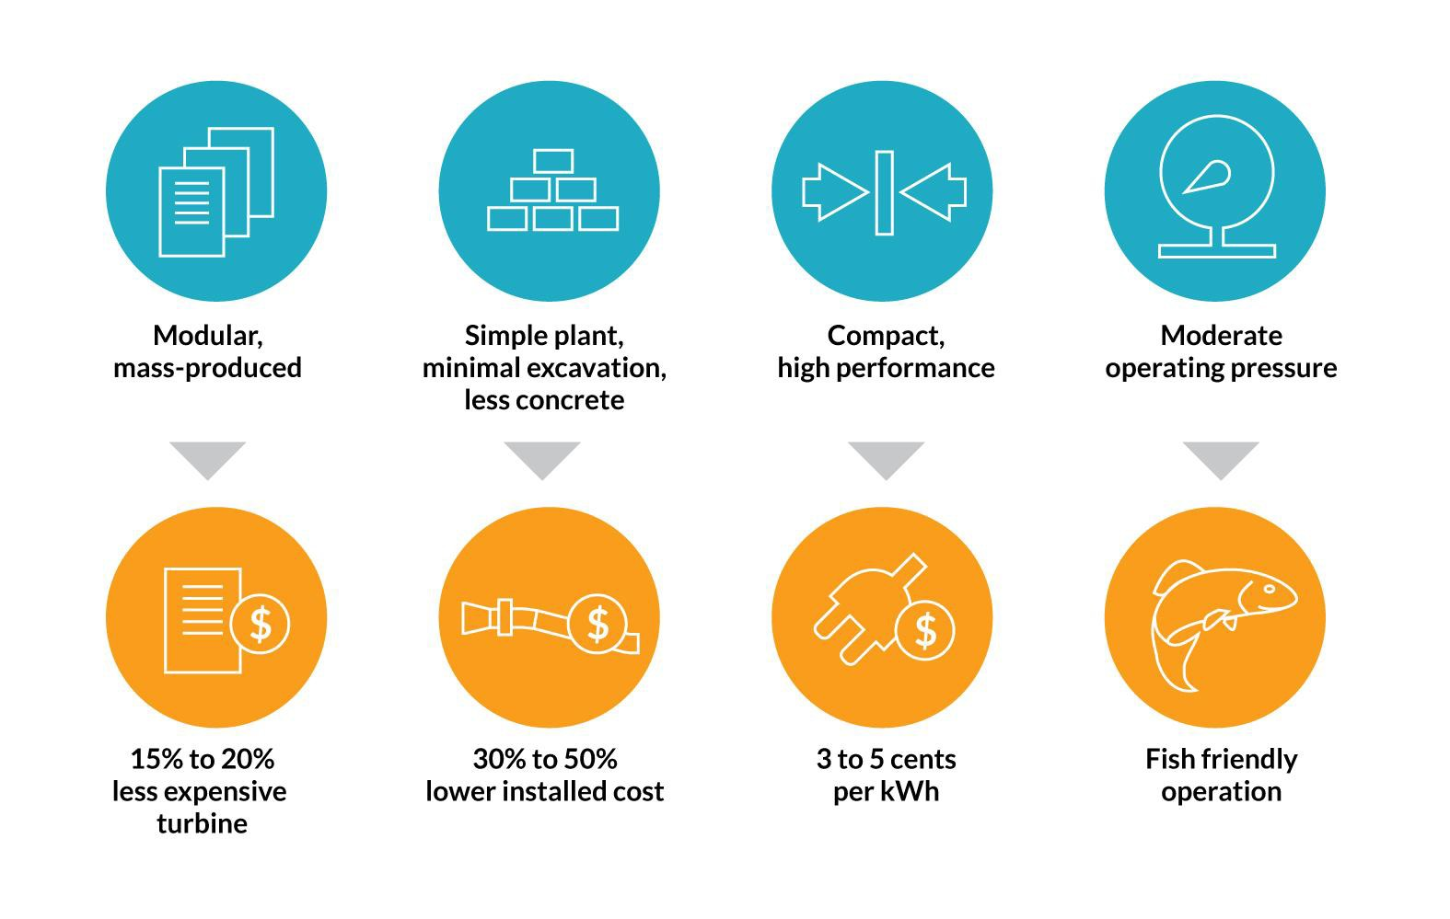
Hardware Innovation: the hydroEngine™
A new fish friendly turbine designed for high performance in low pressure, high flow settings with simplified civil works and installation.

Slide 5
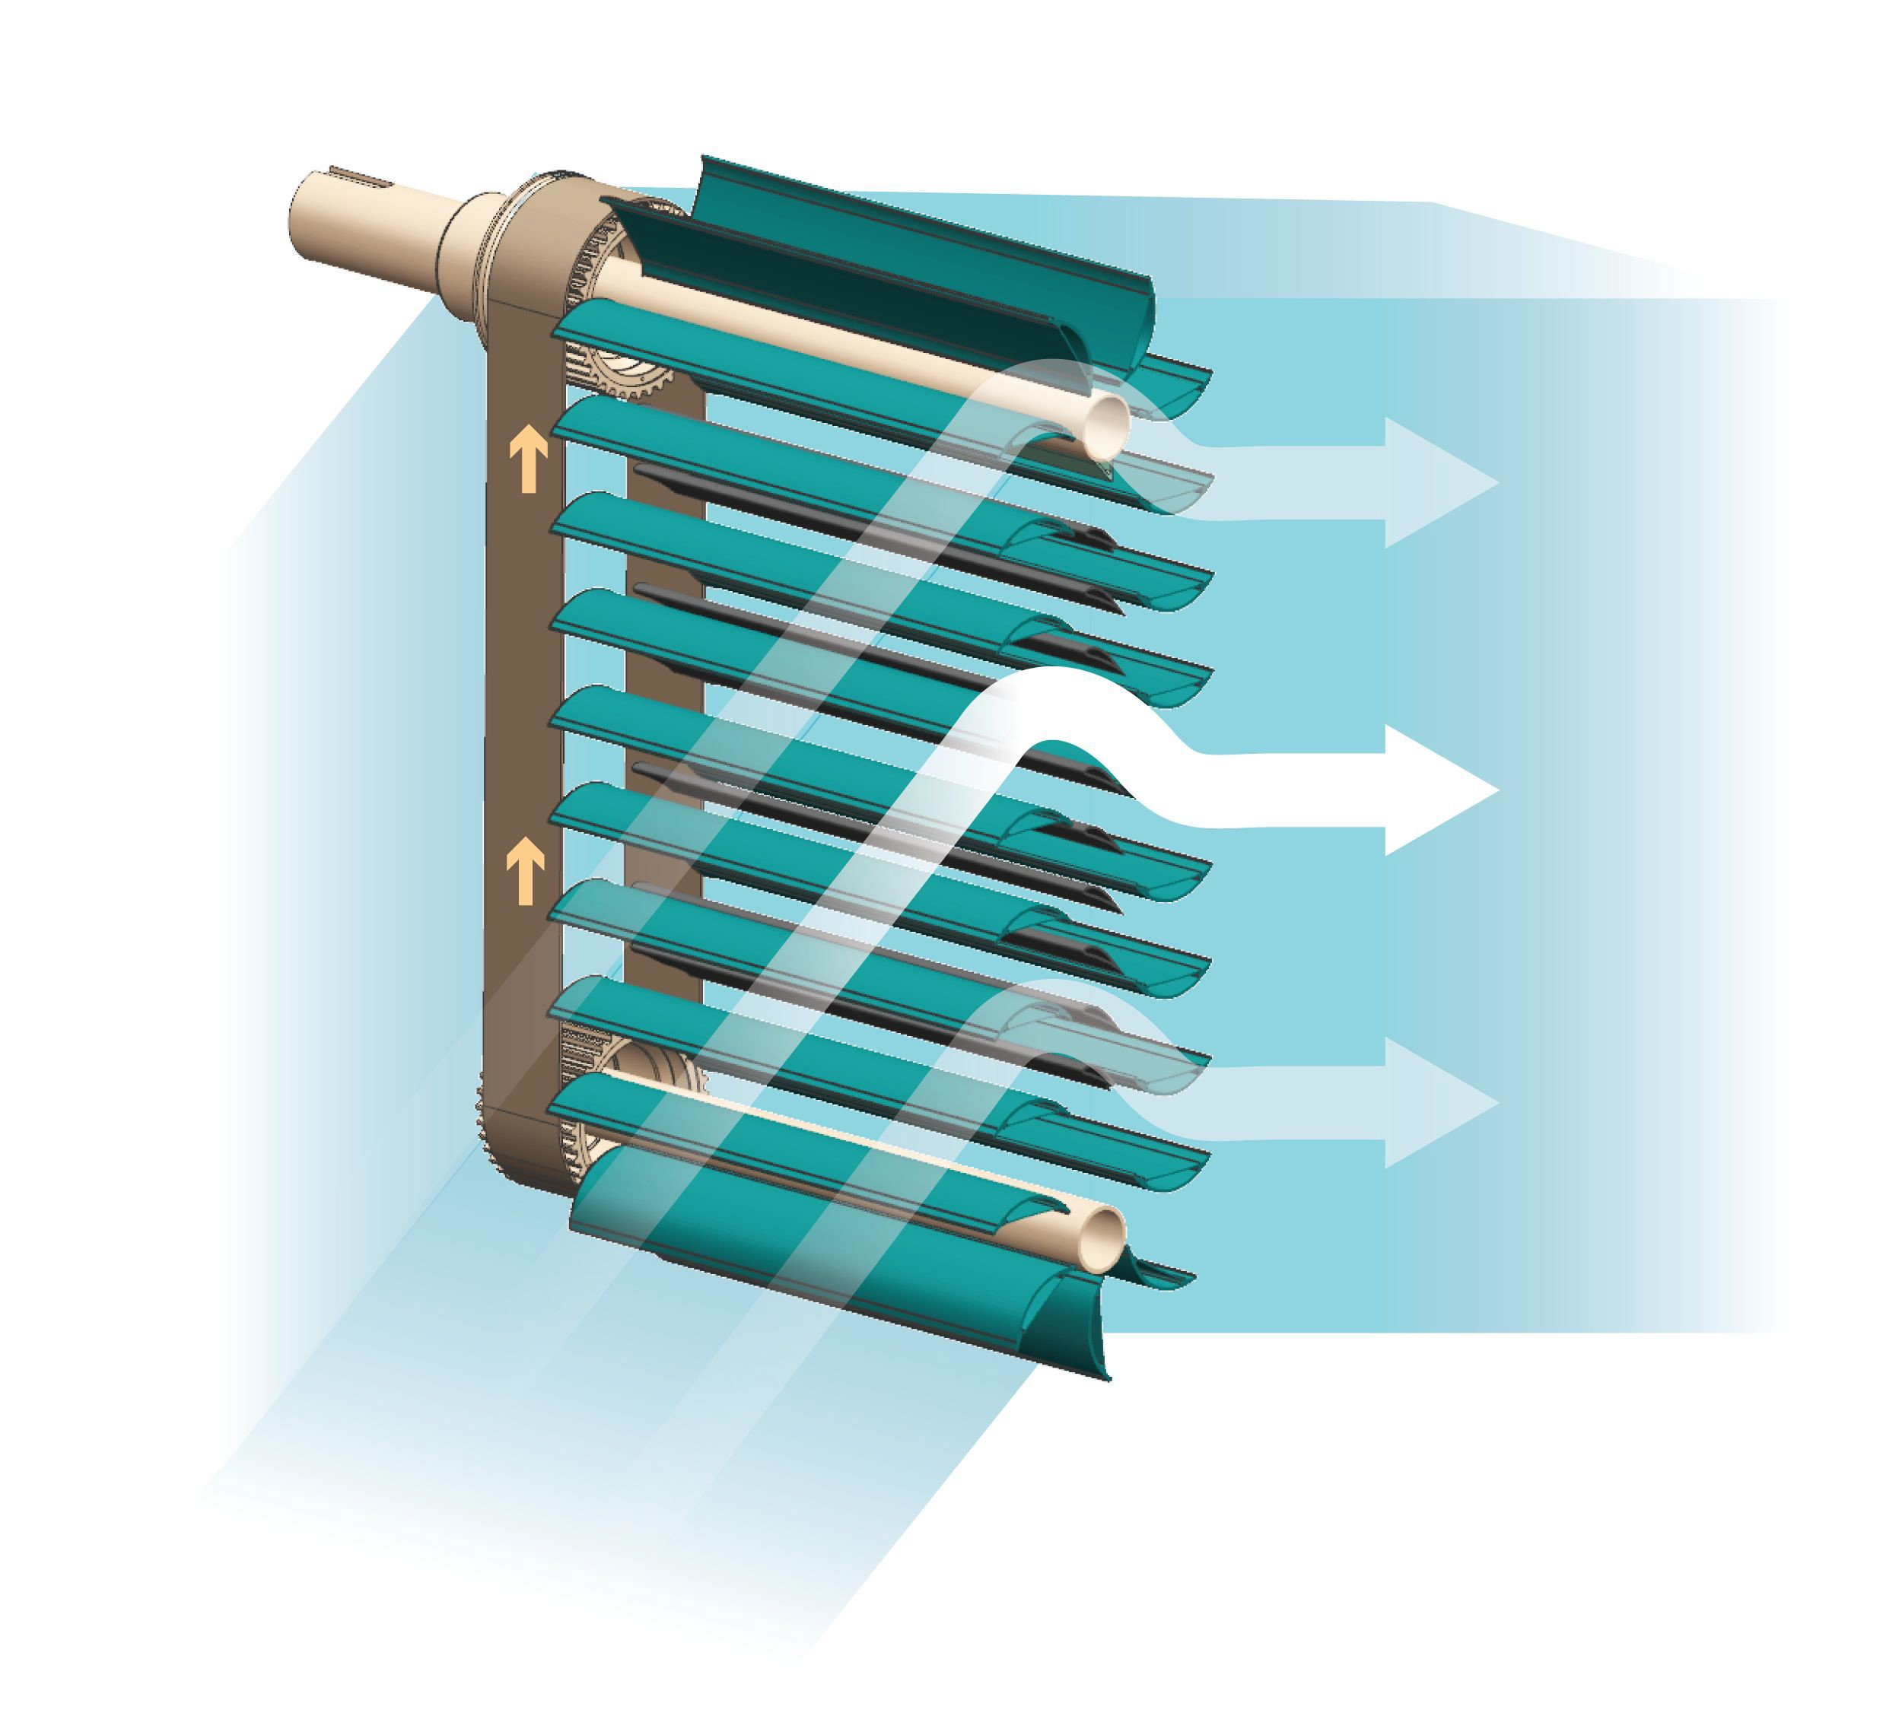
How it works: the hydroEngine™
Linear Drive Train
As water flows through the hydroEngine, the blades are driven in linear paths around two parallel shafts. Mechanical energy from the shafts drives a conventional generator. Water enters the penstock, passes through the unit, and exits downstream.
Impulse blade design results in no pressure drop across blades
Modular, standardized
Combines advanced and traditional
manufacturing (carbon + steel)

Slide 6
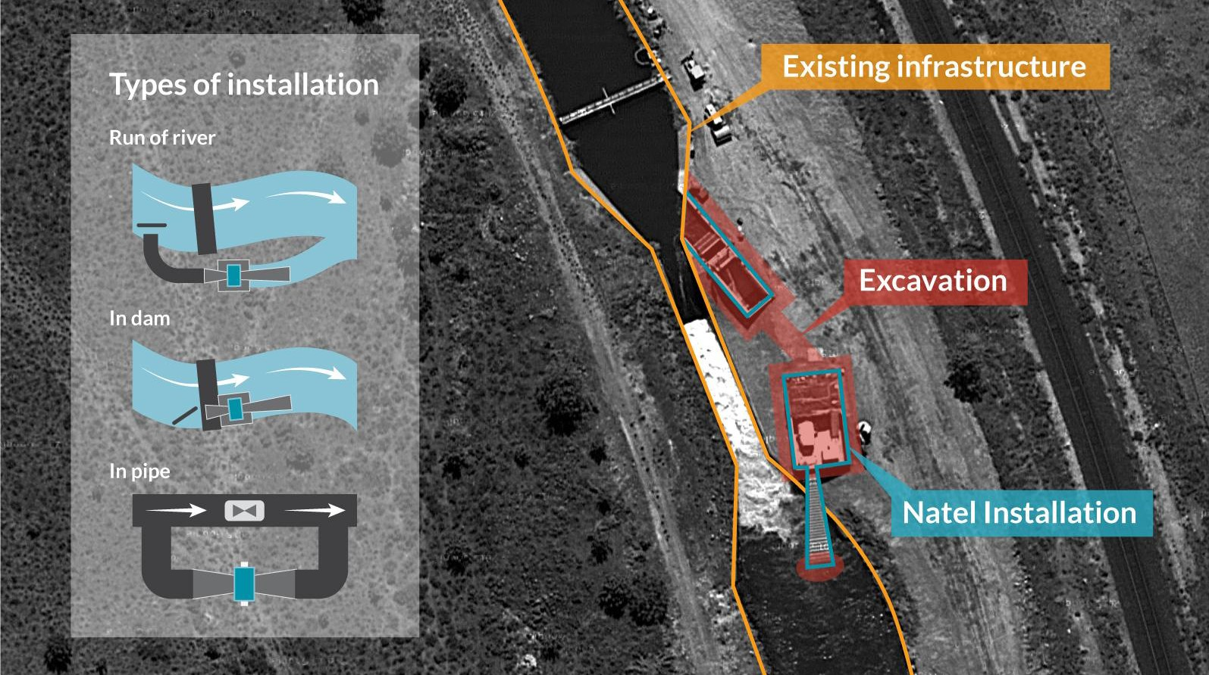
How it works: a project

Slide 7
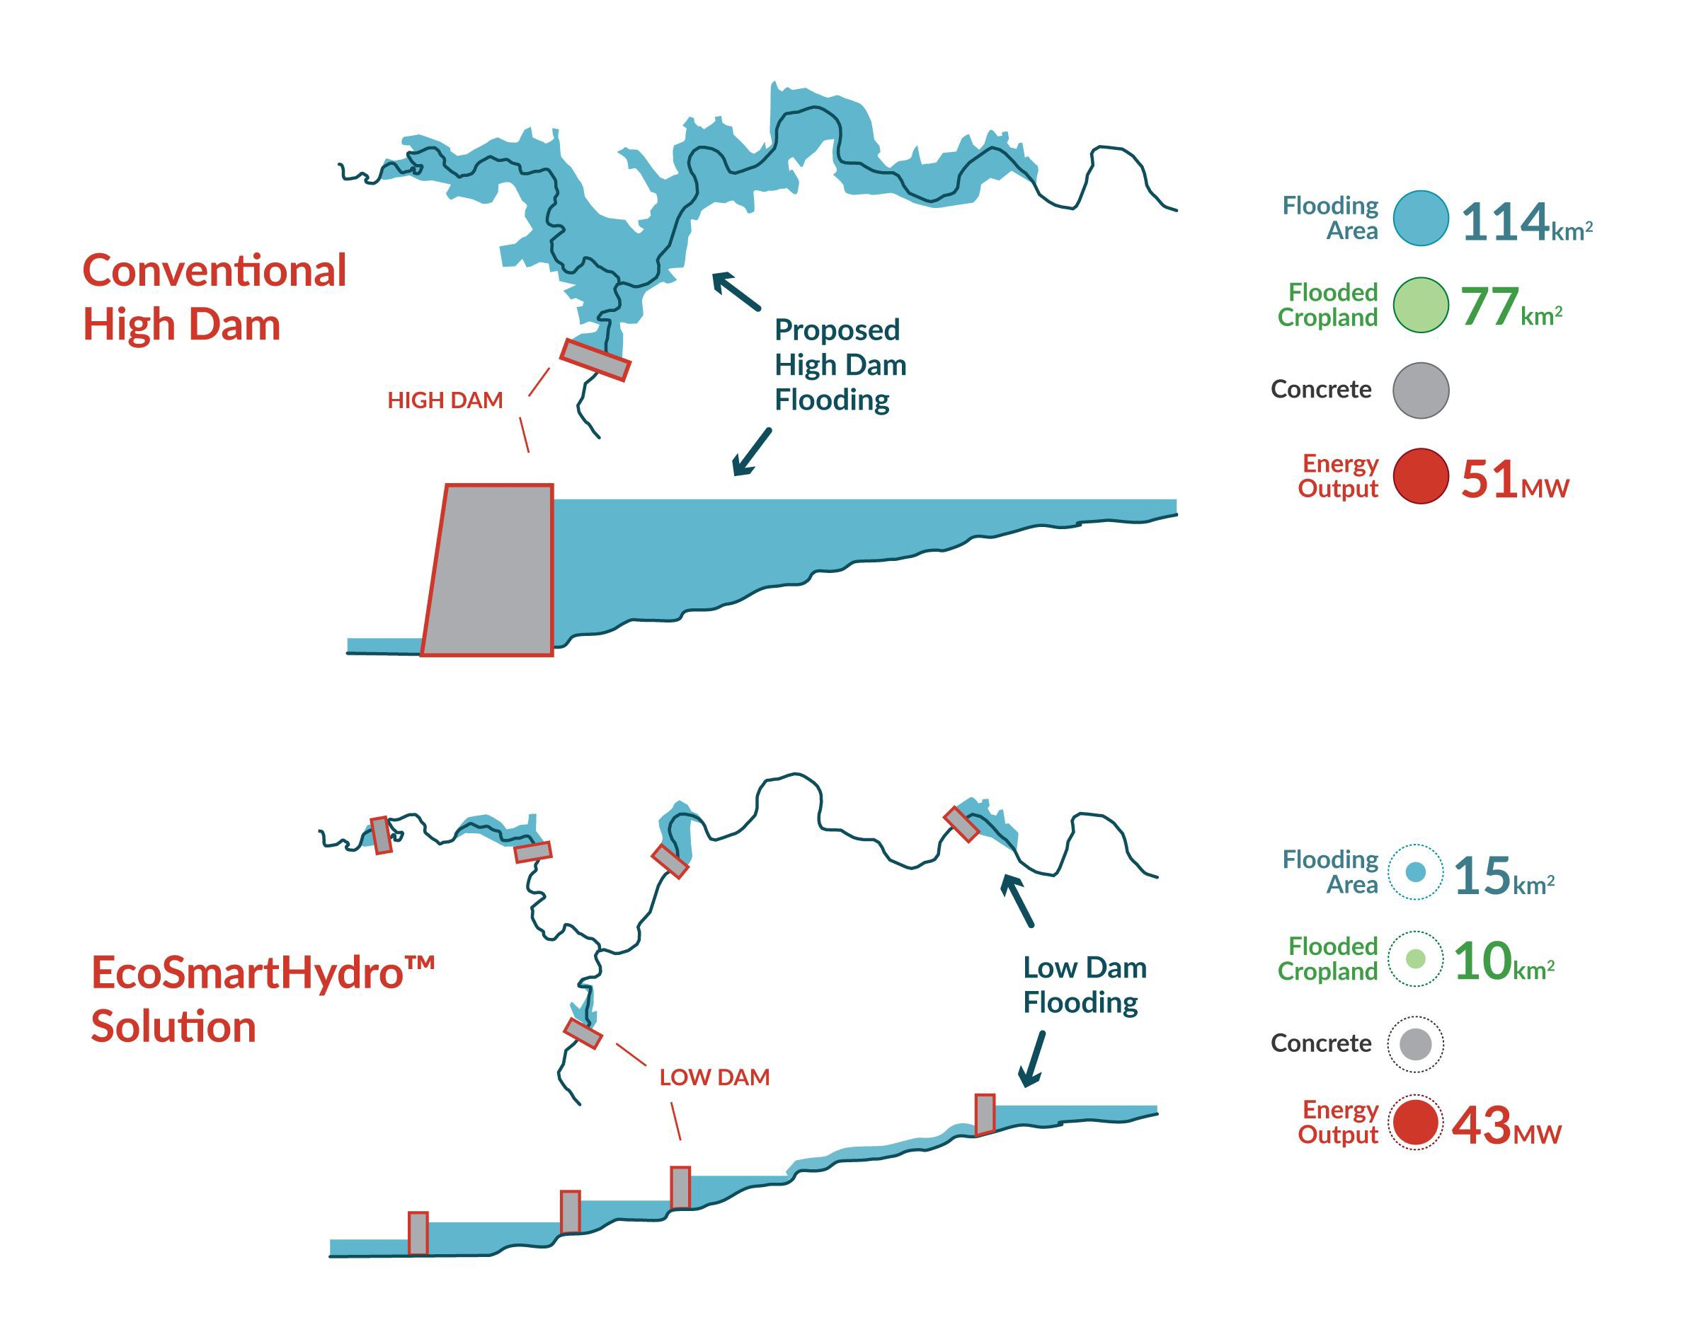
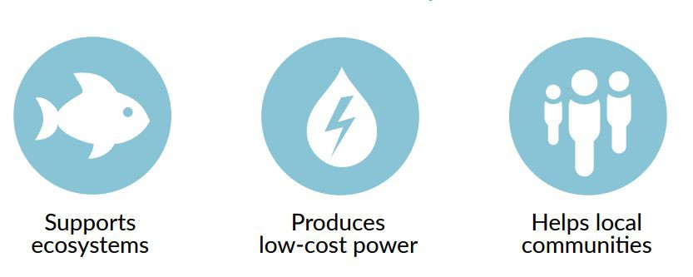
How it works: EcoSmartHydro™
EcoSmartHydroTM is a blueprint.
It is the design, implementation, and management of hydropower systems that are climate resilient and that create co-benefits to enhance the health of local ecosystems and communities.

Slide 8
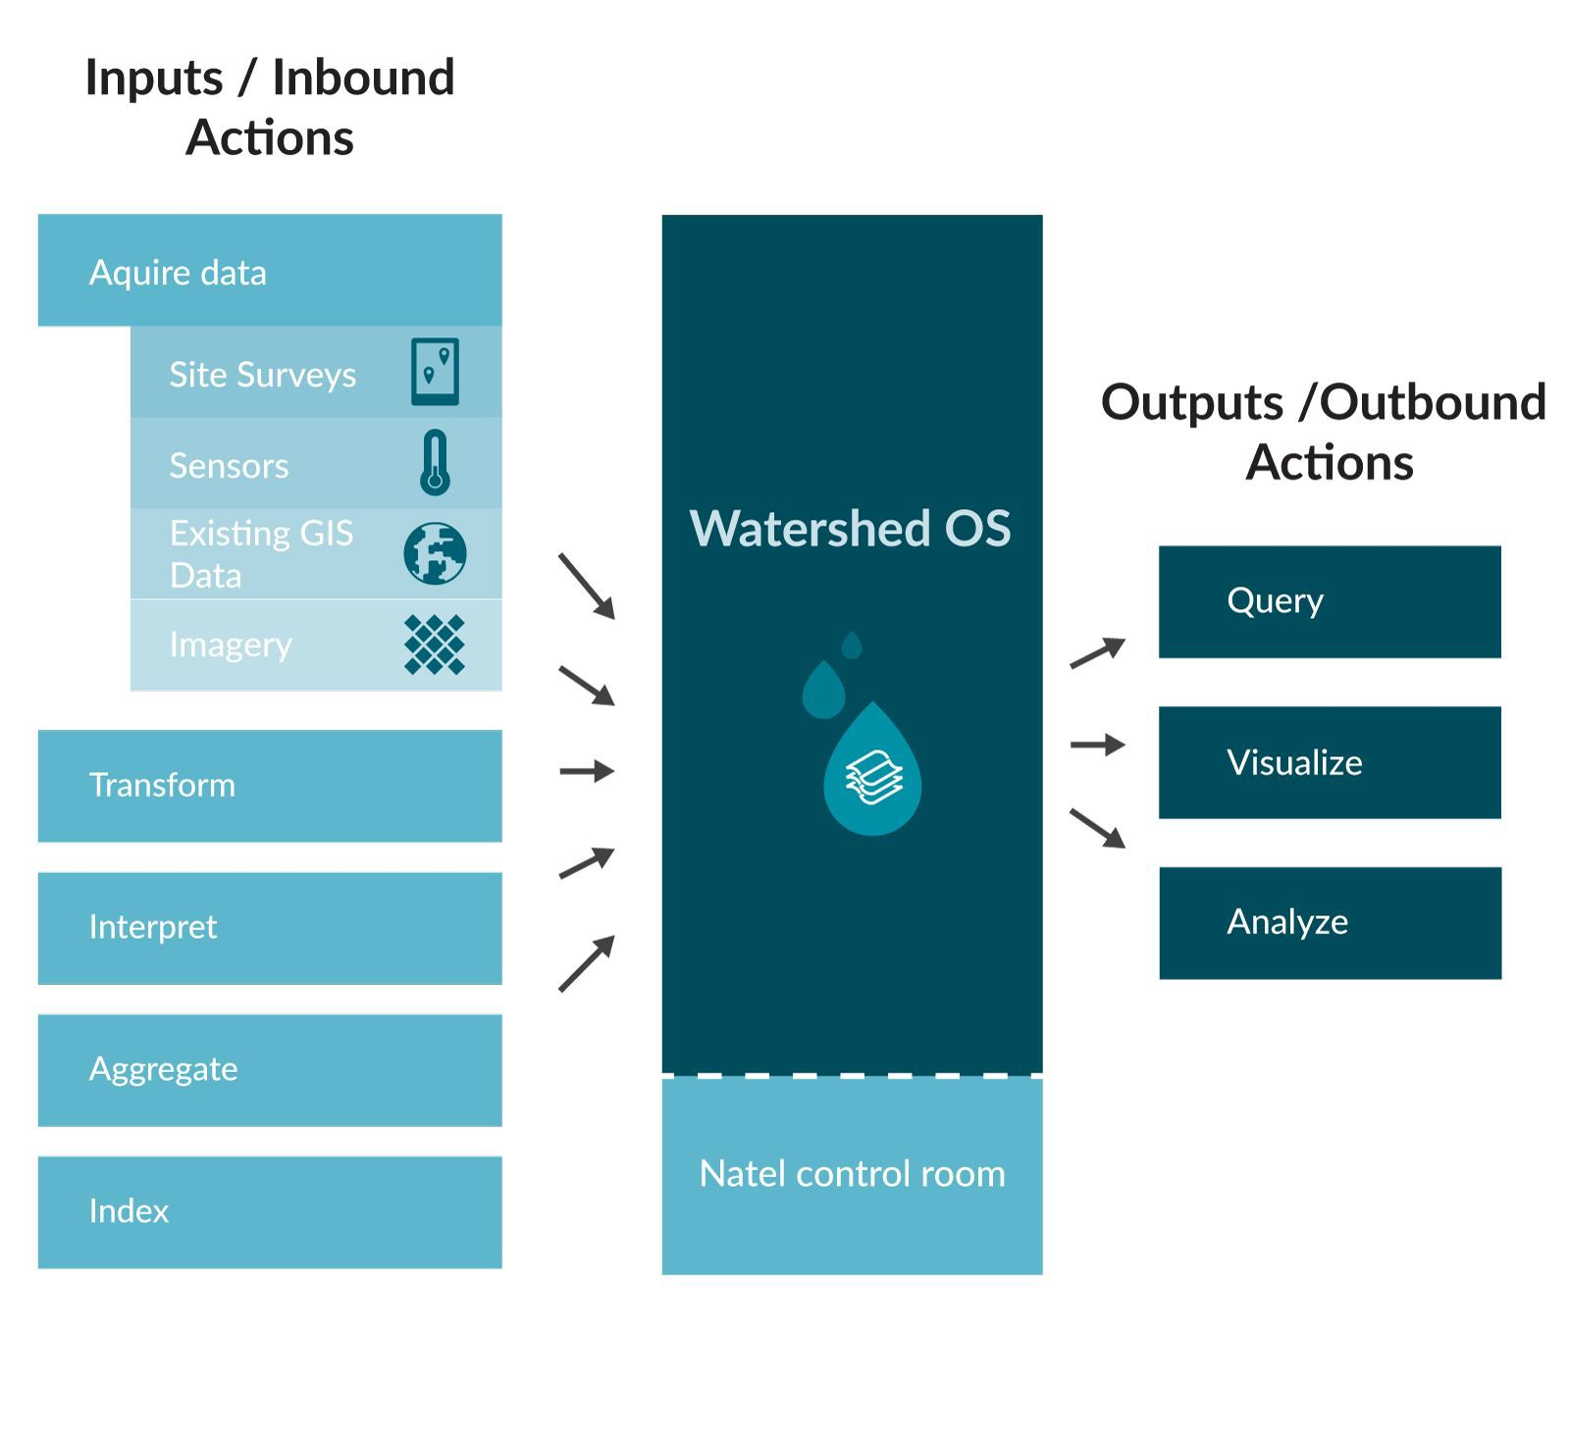
Software Innovation
watershedOS: a knowledge and analytics platform for water+energy projects
Solution: Interactive cloud deployed dashboards updated in real / near real time
wOS Developer
identify, screen, design and develop EcoSmartHydro™ projects to achieve prioritized results (eg: dispatchable hydro, groundwater recharge, runoff management, wetland restoration, etc)
wOS Manager
connect, monitor and manage distributed EcoSmartHydro™ projects to create an intelligent, networked, responsive system that optimizes the natural resource productivity of water and watersheds for energy, environment and economics
8

Slide 9
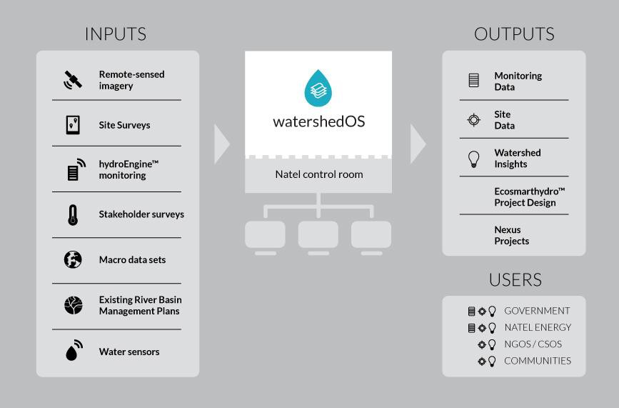
Natel’s watershedOS enables public and private sector stakeholders to optimize
watershed development for low-carbon prosperity and long-term sustainability in conjunction with EcoSmartHydroTM development with Natel’s hydroEngineTM.
9

Slide 10
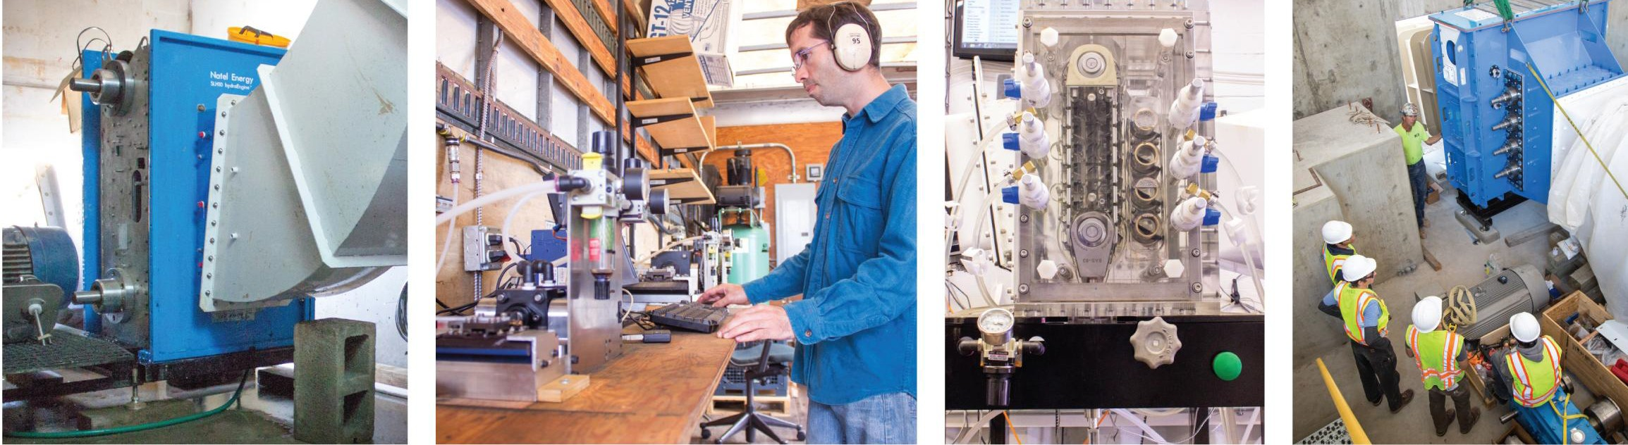
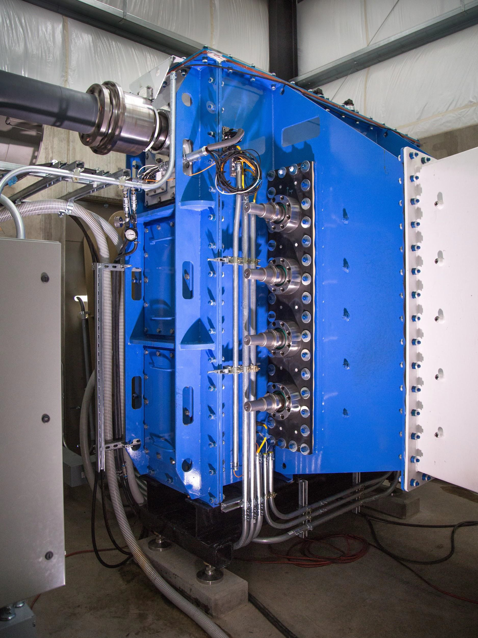
Leading Hydropower Innovation
Natel Energy’s world class engineering team is creating new hydropower solutions.
Incorporating advanced manufacturing materials and methods
Buckeye Pilot Project grid connected R&D site since April 2010 (5+years)
First commercial project - Monroe Hydro - commissioned in Oregon in September 2015
>100 million cycle fatigue testing with no failures
SLH10 Buckeye pilot grid connected for 5+ years
SLH100 component fatigue testing commenced in 2012
>100 million cycles
SLH hydraulic scale model performance test facility comes online in 2013
SLH100 first commercial Monroe Hydro Project commissioned in Q3 2015
10

Slide 11
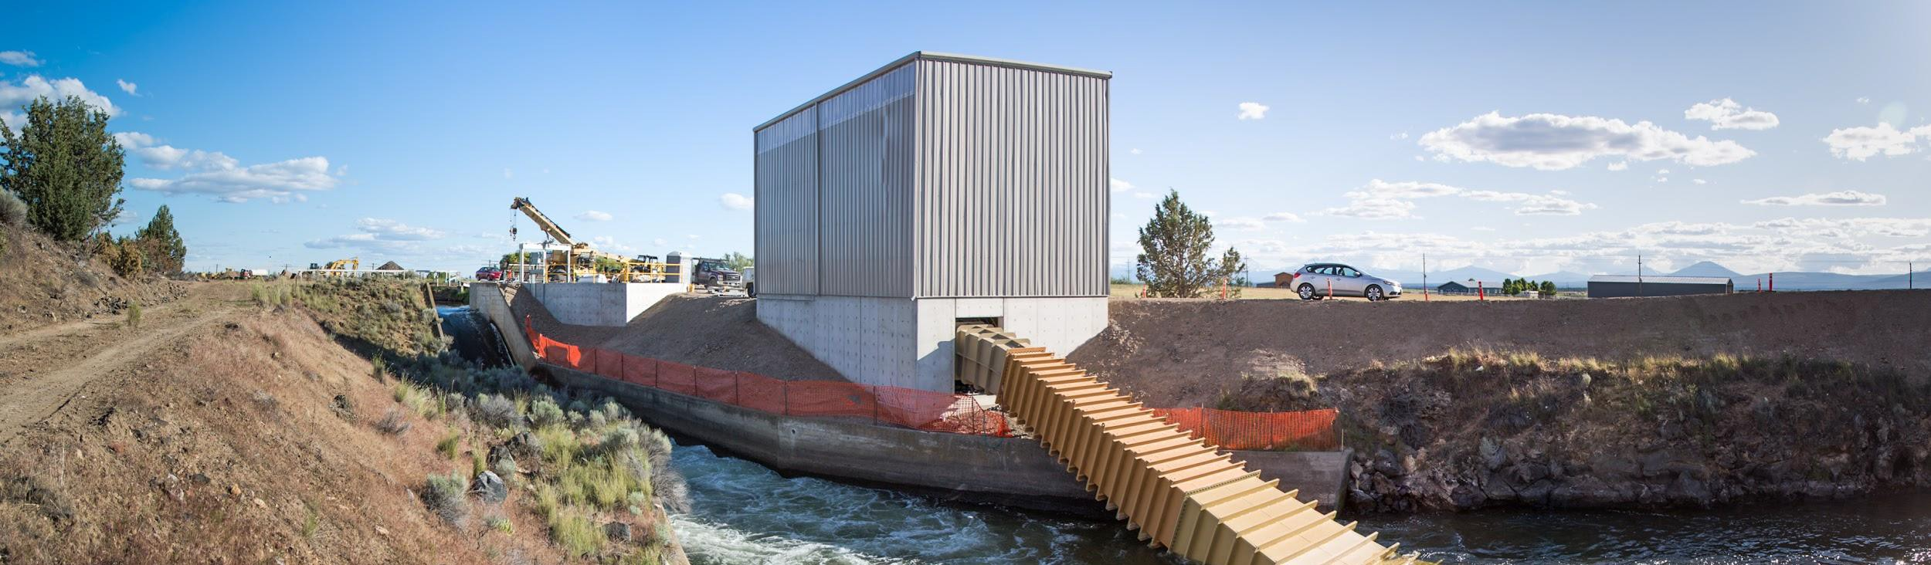
Projects
Initial Sales & Early Adopters
3 Year Pipeline
Engine Sales + Service
Unit sales with 20 year monitoring and maintenance contract
Freedom Falls LLC: Maine Mayo Mill Holdings LLC: Maine
Total: 35 MW
Turnkey Project Sales + O&M
Project sales with 10 to 20 year O&M contract
Apple: Monroe Hydro, Oregon
Total: 25 MW
watershedOS
consulting, software license and SAAS
Druk Holdings: Bhutan
Ministry of Energy: Chile
11

Slide 12
Monroe Hydro, Oregon

Slide 13
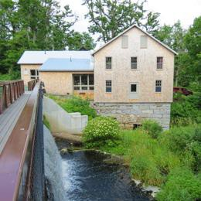
Freedom Falls, Maine
The Kleinshmidt Group broke ground on construction of an plant in Freedom Falls, Maine at the end of 2015.
The project is part of a rehabilitation effort of a historic mill site, in which the hydroEngine will be installed at a previously abandoned powerhouse and generation site.
The project is schedule for commissioning in the spring of 2016.
13

Slide 14
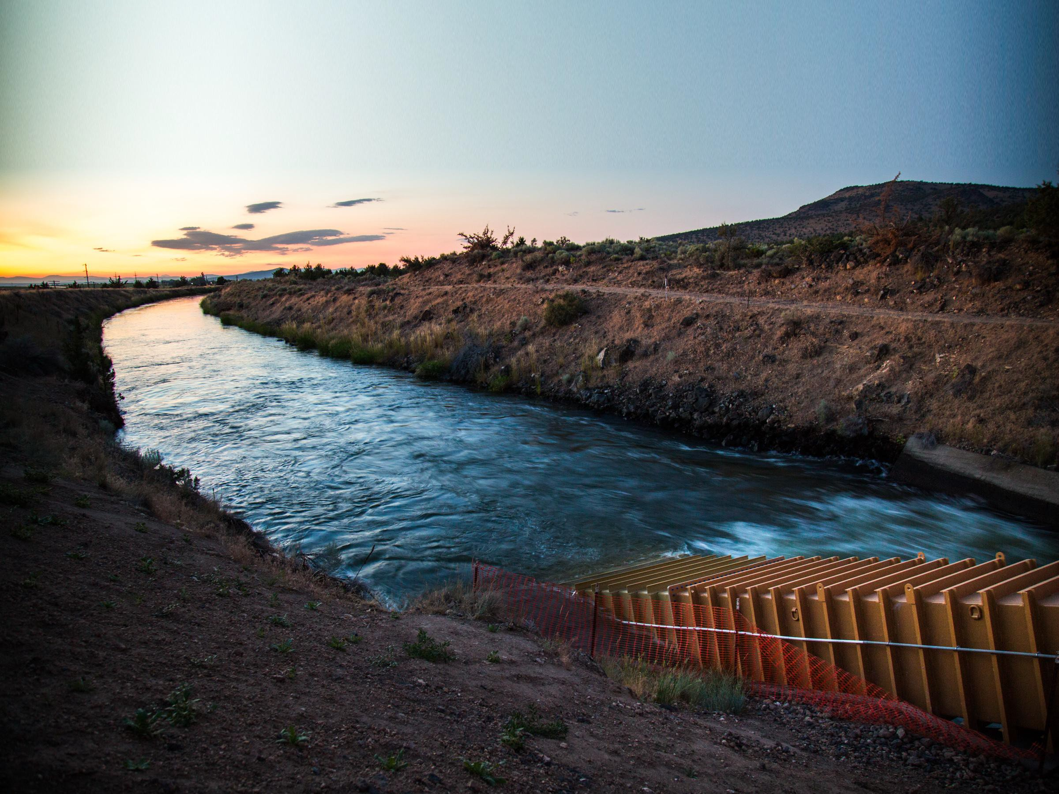
Thank you
Gia Schneider
CEO
+1 510 342 5269 or +1 510 863 1002
gia@natelenergy.com
Meghan Harwood Commercial Associate 508 314 6400
meghan@natelenergy.com
www.natelenergy.com

